Slide 1
Chapter 1
Overview of Electronic Commerce

Slide 2
Learning
Define electronic commerce (EC) and describe its various categories.
Describe and discuss the content and framework of EC.
Describe the major types of EC transactions.
Discuss e-commerce 2.0.
Describe social commerce and social software.

Slide 3
Learning Objectives
Understand the elements of the digital world.
Describe the drivers of EC as they relate to business pressures and organizational responses.
Describe some EC business models.
Describe the benefits of EC to organizations, consumers, and society.
List and describe the major limitations of EC.

Slide 4
Electronic Commerce: Definitions and Concepts
electronic commerce (EC)
The process of buying, selling, or exchanging products, services, or information via computer
e-business
A broader definition of EC that includes not just the buying and selling of goods and services, but also servicing customers, collaborating with business partners, and conducting electronic transactions within an organization

Slide 5
Electronic Commerce: Definitions and Concepts
MAJOR EC CONCEPTS
Pure Versus Partial EC
EC Organizations
brick-and-mortar (old economy) organizations
Old-economy organizations (corporations) that perform their primary business offline, selling physical products by means of physical agents
virtual (pure-play) organizations
Organizations that conduct their business activities solely online
click-and-mortar (click-and-brick) organizations
Organizations that conduct some e-commerce activities, usually as an additional marketing channel

Slide 6
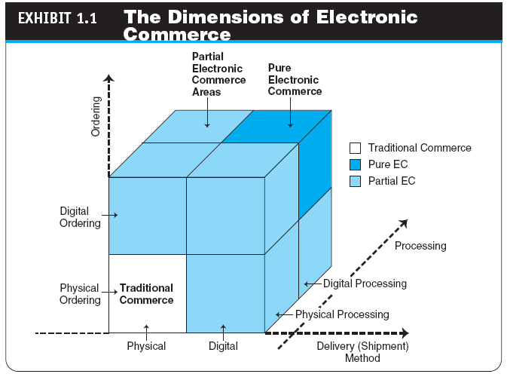

Slide 7
Electronic Commerce: Definitions and Concepts
ELECTRONIC MARKETS AND NETWORKS
electronic market (e-marketplace)
An online marketplace where buyers and sellers meet to exchange goods, services, money, or information
intranet
An internal corporate or government network that uses Internet tools, such as Web browsers, and Internet protocols
extranet
A network that uses the Internet to link multiple intranets

Slide 8
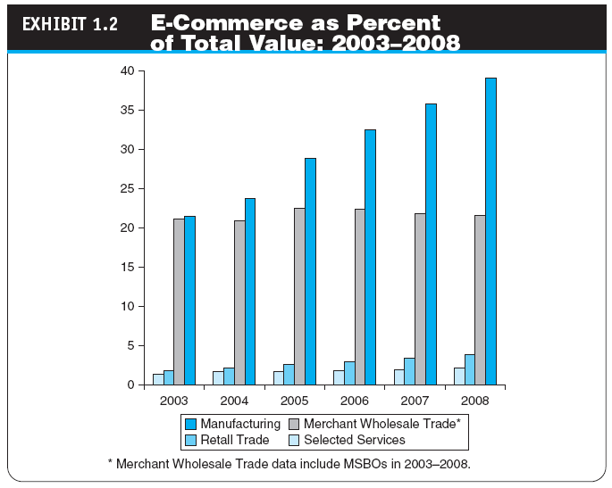

Slide 9
The Electronic Commerce Field: Classification, Content, and a Brief History
AN EC FRAMEWORK
EC applications are supported by infrastructure and by the following five support areas:
People
Public policy
Marketing and advertising
Support services
Business partnerships

Slide 10
The Electronic Commerce Field: Classification, Content, and a Brief History
CLASSIFICATION OF EC BY THE NATURE OF THE TRANSACTIONS AND THE RELATIONSHIPS AMONG PARTICIPANTS
business-to-business (B2B)
E-commerce model in which all of the participants are businesses or other organizations
business-to-consumer (B2C)
E-commerce model in which businesses sell to individual shoppers
e-tailing
Online retailing, usually B2C

Slide 11
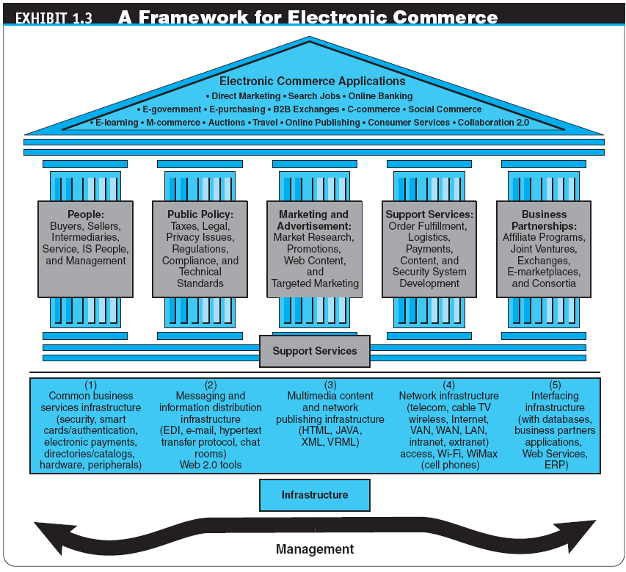

Slide 12
The Electronic Commerce Field: Classification, Content, and a Brief History
business-to-business-to-consumer (B2B2C)
E-commerce model in which a business provides some product or service to a client business that maintains its own customers
consumer-to-business (C2B)
E-commerce model in which individuals use the Internet to sell products or services to organizations or individuals who seek sellers to bid on products or services they need

Slide 13
The Electronic Commerce Field: Classification, Content, and a Brief History
intrabusiness EC
E-commerce category that includes all internal organizational activities that involve the exchange of goods, services, or information among various units and individuals in an organization
business-to-employees (B2E)
E-commerce model in which an organization delivers services, information, or products to its individual employees

Slide 14
The Electronic Commerce Field: Classification, Content, and a Brief History
consumer-to-consumer (C2C)
E-commerce model in which consumers sell directly to other consumers
collaborative commerce (c-commerce)
E-commerce model in which individuals or groups communicate or collaborate online
e-government
E-commerce model in which a government entity buys or provides goods, services, or information from or to businesses or individual citizens

Slide 15
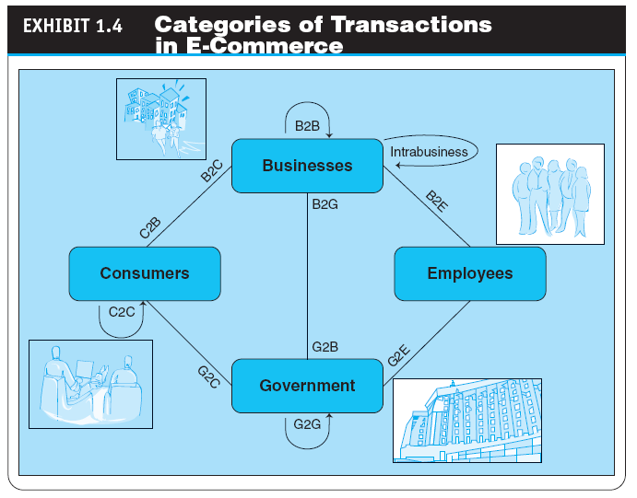

Slide 16
The Electronic Commerce Field: Classification, Content, and a Brief History
A BRIEF HISTORY OF EC
The Interdisciplinary Nature of EC
The Google Revolution
f-commerce
E-commerce activities conducted on Facebook or influenced by the site
EC Failures
EC Successes
THE FUTURE OF EC

Slide 17
E-Commerce 2.0: From Social Commerce to Virtual Worlds
social computing
An approach aimed at making the human–computer interface more natural
Web 2.0
The second generation of Internet-based services that lets people collaborate and share information online in new ways, such as social networking sites, wikis, communication tools, and folksonomies

Slide 18
E-Commerce 2.0: From Social Commerce to Virtual Worlds
social network
A category of Internet applications that help connect friends, business partners, or individuals with specific interests by providing free services such as photo presentation, e-mail, blogging, and so on using a variety of tools

Slide 19
E-Commerce 2.0: From Social Commerce to Virtual Worlds
social networking service (SNS)
A service that builds online communities by providing an online space for people to build free homepages and that provides basic communication and support tools for conducting different activities in the social network
social networking
The creation or sponsoring of a social network service and any activity, such as blogging, done in a social network (external or internal)

Slide 20
E-Commerce 2.0: From Social Commerce to Virtual Worlds
ENTERPRISE SOCIAL NETWORKS
social commerce
The e-commerce activities conducted in social networks and/or by using social software (i.e., Web 2.0 tools)

Slide 21
E-Commerce 2.0: From Social Commerce to Virtual Worlds
VIRTUAL WORLDS AND SECOND LIFE
virtual world
A user-defined world in which people can interact, play, and do business; the most publicized virtual world is Second Life
How Students Make Money in a Virtual World
THE MAJOR TOOLS OF WEB 2.0
Wikis
RSS feeds
Blogs
Microblogs (e.g.,Twitter)

Slide 22
The Digital World: Economy, Enterprises, and Society
digital economy
An economy that is based on digital technologies, including digital communication networks, computers, software, and other related information technologies; also called the Internet economy, the new economy, or the Web economy

Slide 23
The Digital World: Economy, Enterprises, and Society
digital enterprise
A new business model that uses IT in a fundamental way to accomplish one or more of three basic objectives: reach and engage customers more effectively, boost employee productivity, and improve operating efficiency; uses converged communication and computing technology in a way that improves business processes
corporate portal
A major gateway through which employees, business partners, and the public can enter a corporate website.
THE DIGITAL SOCIETY

Slide 24
The Changing Business Environment, Organizations’ Response, and EC Support
THE CHANGING BUSINESS ENVIRONMENT
PERFORMANCE, BUSINESS PRESSURES, AND ORGANIZATIONAL RESPONSES AND EC SUPPORT
The Business Environment and Performance Impact Model
Business Pressures
Organizational Response Strategies
The support of EC
The Major Capabilities of E-Commerce

Slide 25
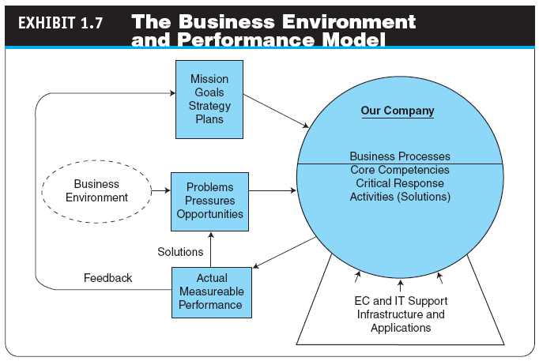

Slide 26
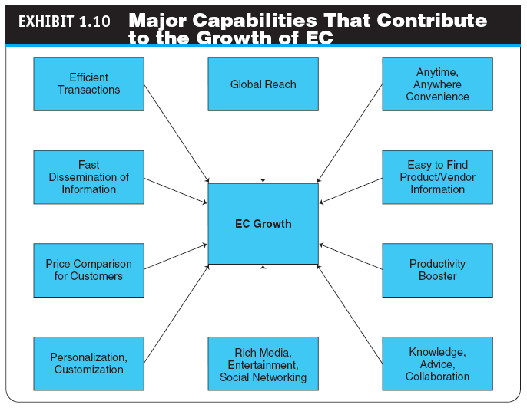

Slide 27
Electronic Commerce Business Models
business model
A method of doing business by which a company can generate revenue to sustain itself

Slide 28
Electronic Commerce Business Models
THE STRUCTURE AND PROPERTIES OF BUSINESS MODELS
Revenue Models
value proposition
The benefits a company can derive from using EC
Functions of a Business Model

Slide 29
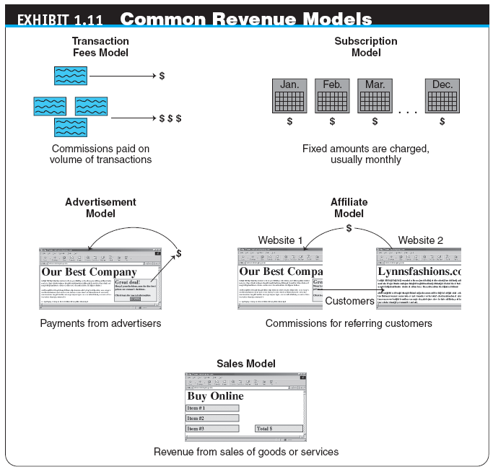

Slide 30
Electronic Commerce Business Models
TYPICAL EC BUSINESS MODELS
Online direct marketing
tendering (bidding) system
Model in which a buyer requests would-be sellers to submit bids; the lowest bidder wins.
Electronic marketplaces and exchanges
Viral marketing
Group purchasing

Slide 31
Benefits, Limitations, and Impacts of Electronic Commerce
THE BENEFITS AND IMPACTS OF EC
EC as a Provider of Competitive Advantage
THE LIMITATIONS AND BARRIERS OF EC
ethics
The branch of philosophy that deals with what is considered to be right and wrong
WHY STUDY E-COMMERCE?

Slide 32
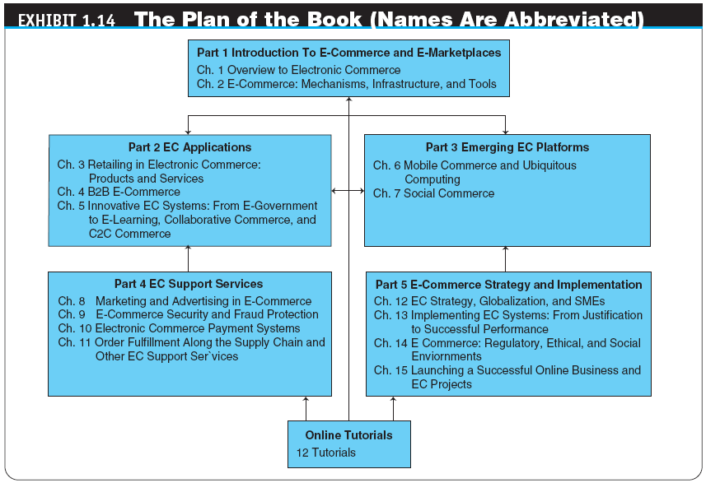

Slide 33
Managerial Issues
Is EC real?
Why is B2B e-commerce so essential and successful?
Which EC business model should I choose?
How can we exploit social commerce?
What are the top challenges of EC today?

Slide 34
Summary
Definition of EC and description of its various categories
The content and framework of EC
The major types of EC transactions
E-commerce 2.0
Description of social commerce and social software

Slide 35
Summary
The elements of the digital world
The drivers of EC
The major EC business models
Benefits of EC to organizations, consumers, and society
Limitations of e-commerce

Slide 36
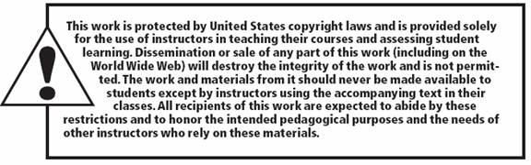
All rights reserved. No part of this publication may be reproduced, stored in a retrieval system, or transmitted, in any form or by any means, electronic, mechanical, photocopying, recording, or otherwise, without the prior written permission of the publisher. Printed in the United States of America.
Copyright © 2012 Pearson Education, Inc.
Publishing as Prentice Hall

